Slide 1
Grievance Redressal System
Dr. A.P.J. Abdul Kalam Technical University, Lucknow

Slide 2
Welcome to Presentation on Grievance Redressal System

Slide 3
Grievance Redressal System Introduction
The Grievance Redressal Cell (GRC) aims to look into the complaints lodged by any student and redress it as per requirement. The students can state their grievance regarding any academic and non- academic matter within the campus through the online and grievance/ suggestion box. The institution aims at solving the grievances of the students within stipulated academic and non- academic matter within the campus through the online and grievance/ suggestion box. The institution aims at solving the grievances of the students within stipulated time.

Slide 4
Problem Statement
Student satisfaction is a major concern for any educational institute. However, many a time the students fail to express their concerns & issues or fail to reach out for proper support from the organization. Neither is there any system to address the conflicts or issues faced by the students. This eventually leads to students' dissatisfaction. Hence, to maintain the dignity of the college or institute by ensuring a conflict-free atmosphere by promoting good student-teacher relationships we have developed a Student Grievance System that will address the students' issues & grievances. The students can lodge their complaints through this system which will be redressed by the institute. This grievance cell will also look into matters of harassment thus creating a protective environment for students.

Slide 5
Scope of GRC
Academic Matters: Related to timely issue of duplicate Mark-sheets, Transfer Certificates, Conduct Certificates or other examination related matters.
Financial Matters: Related to dues and payments for various items from library, hostels etc.
Other Matters: Related to certain misgivings about conditions of sanitation, preparation of food, availability of transport, victimization by teachers etc.

Slide 6
Objectives of GRC
The Grievance Redressal Cell has been developed to settle the grievances of the students and other stakeholders within a reasonable time period for further strengthening the bond of the students with the institution by providing them with all kind of facilities to a satisfaction level for maintaining a convenient ambience of academic teaching and learning.

Slide 7
Importance of Grievance Redressal System
Student Satisfaction and Well-being: A Student Grievance Redressal System is crucial for ensuring the satisfaction and well-being of students within an educational institution. Addressing their concerns, whether related to academics, facilities, or interpersonal issues, contributes to a positive learning environment, fostering a sense of security and contentment among students.
Maintaining Academic Quality and Integrity: An effective Grievance Redressal System helps uphold the academic quality and integrity of an institution. By promptly addressing grievances related to unfair grading, biased treatment, or other academic matters, the system ensures that the educational experience remains transparent, fair, and conducive to learning.
Building Trust and Accountability: Implementing a transparent and responsive Grievance Redressal System builds trust between students and the educational institution. When students believe that their concerns are taken seriously and resolved fairly, it enhances the institution's credibility and accountability, fostering a positive relationship between the student body and the administration.

Slide 8
Functions
The cases will be attended promptly on receipt of written grievances from the students.
The cell formally will review all cases and will act accordingly as per the Management policy.
The cell will give report to the authority about the cases attended to and the number of pending cases, if any, which require direction and guidance from the higher authorities.

Slide 9
Procedure for Lodging Complaint
The students may feel free to put up a grievance in writing/or in the format available in the admin dept. and drop it in boxes.
The Grievance Cell will act upon those cases which have been forwarded along with the necessary documents.
The Grievance Cell will assure that the grievance has been properly solved in a stipulated time limit provided by the cell.

Slide 10
System Requirements
Hardware Requirement
I3 processor system or higher
4 GB RAM or higher
100 GB ROM or higher
Minimum 350MB Hard Disk space for installation
Software Requirement
Windows 7 or higher
XAMP or WAMP Server
PHP, MySQL, HTML5, CSS3, Java Script, Bootstrap
IDE (Notepad++, Visual Studio Code, or Eclipse.)

Slide 11
Project Life Cycle
The waterfall model is a classical model used in system development life cycle to create a system with a linear and sequential approach. It is termed as waterfall because the model develops systematically from one phase to another in downward fashion. The waterfall approach does not define the process to go back to the previous phase to handle changes in requirement. The waterfall approach is the earliest approach that was used for software development.

Slide 12
The fundamental step used in SDLC process is based on the ISO 9001 guidelines. My aim was to follow the ISO guidelines and develop a perfect system.
The system development was organized into 6 major parts:
Requirement Gathering
Analysis
Documentation/Design
Development/Coding
Testing
Implementation

Slide 13
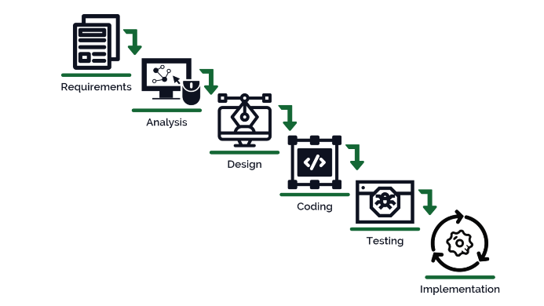

Slide 14
Working of the Project
The system functions to look into the grievances lodged by any student. Students may approach the cell to voice their grievances regarding academic matters, health services, library and other services. Anyone with a genuine grievance may approach the Co-ordinator or member of the Student’s Grievance cell, Grievance cell is formed in order to keep the healthy working atmosphere amongst staff and students, Admin can view the resolving status of all grievance.

Slide 15
Modules of GRS
Login Module
Registration Module
Student Complain Module
Admin Login and Authentication
Complain Progress Management
Dashboard Management
Final Report Management

Slide 16
Student Grievance System
Student
DashBoard
Acc. Setting
Admin
Manage Complaint
Raise Complaint
Complaint Historty
Dept
College
Department
Ref. to
College/
University
Complaint Status
In Process
Closed Complaint
Not yet Processed
University

Slide 17
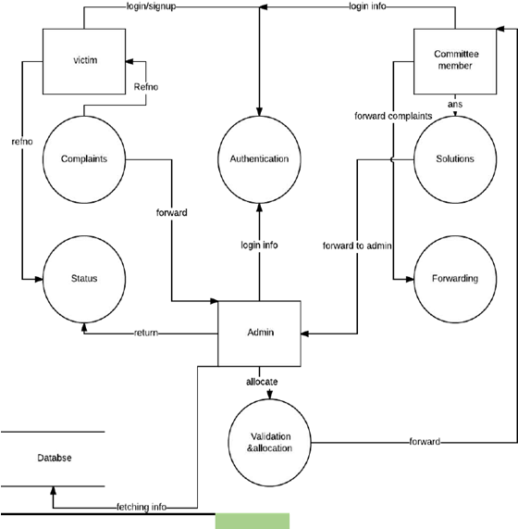
DFD of GRS

Slide 18
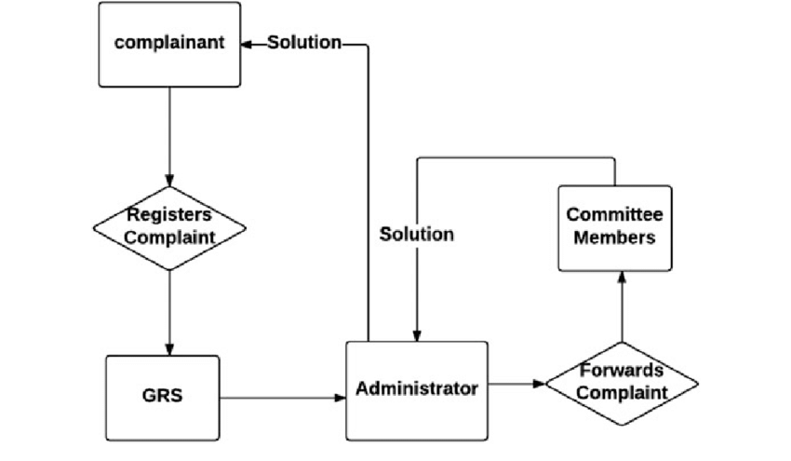
Prototype of the GRS

Slide 19
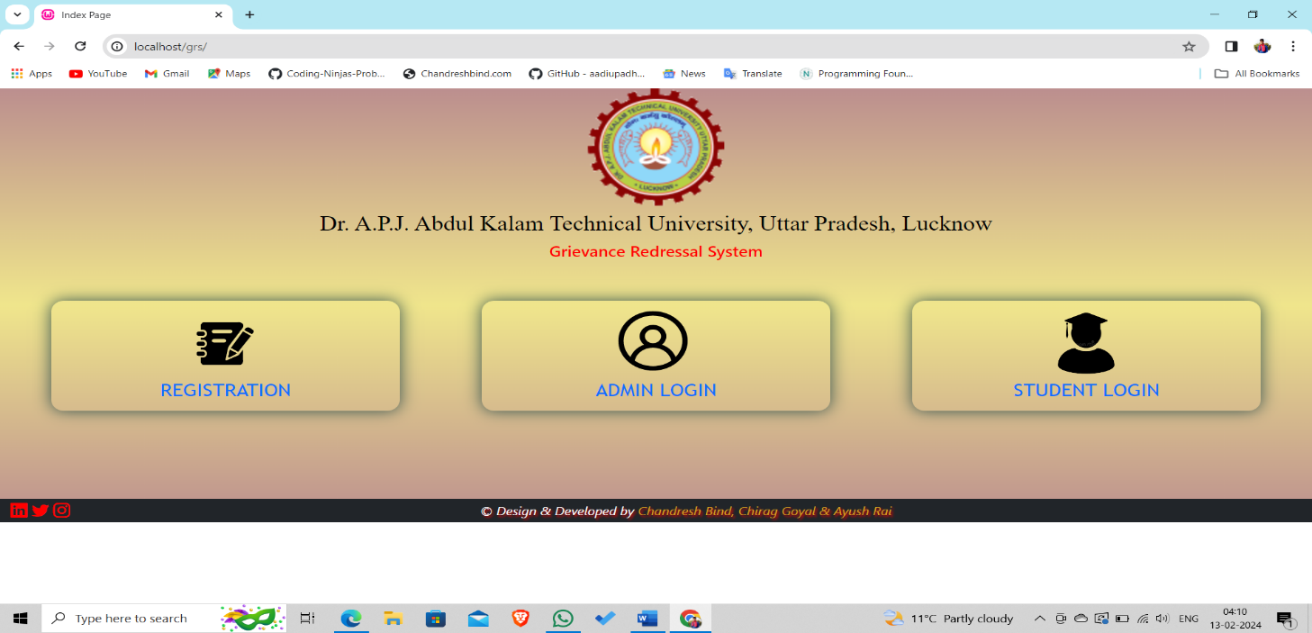
PROJECT SNAPSHOTS

Slide 20
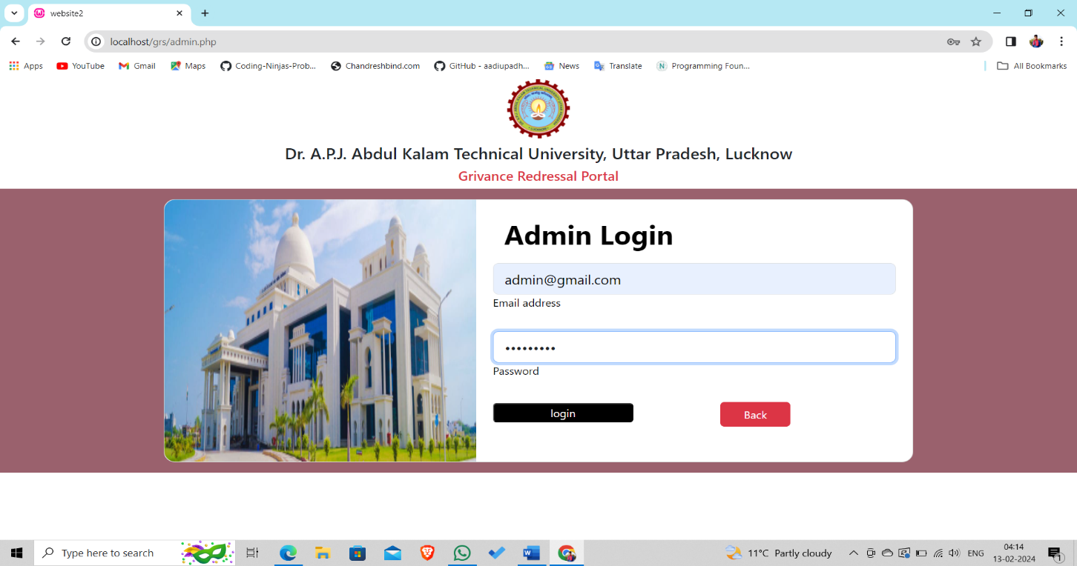
ADMIN LOGIN

Slide 21
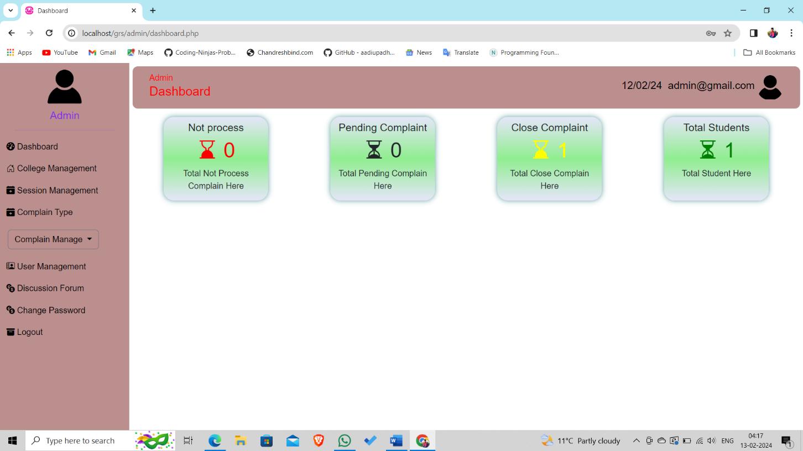
ADMIN DASHBOARD

Slide 22
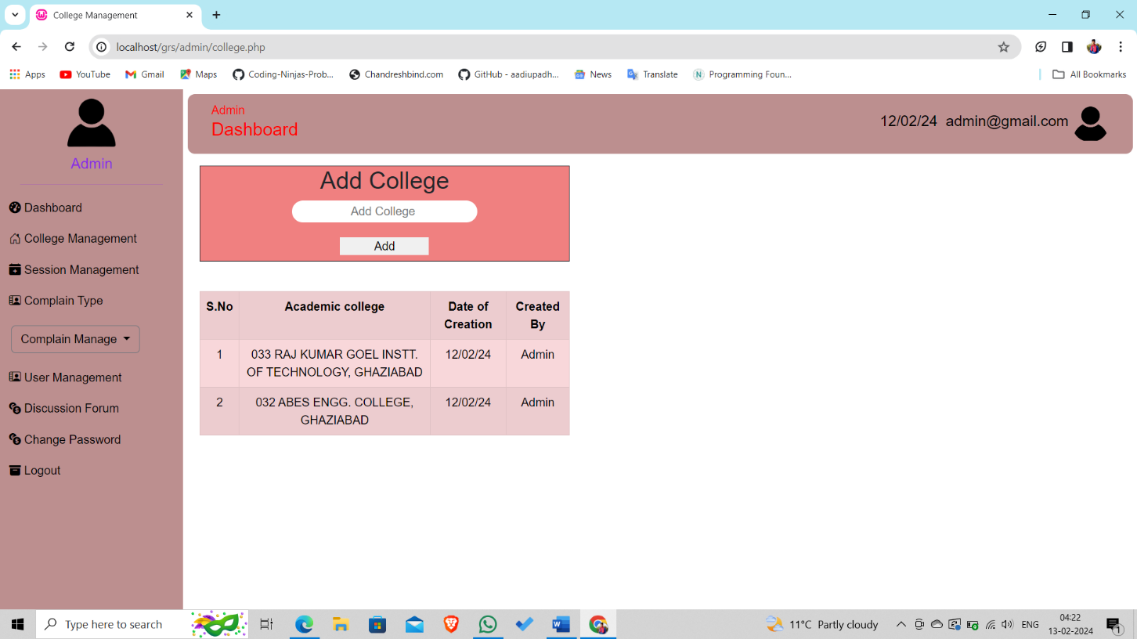
COLLEGE MANAGEMENT

Slide 23
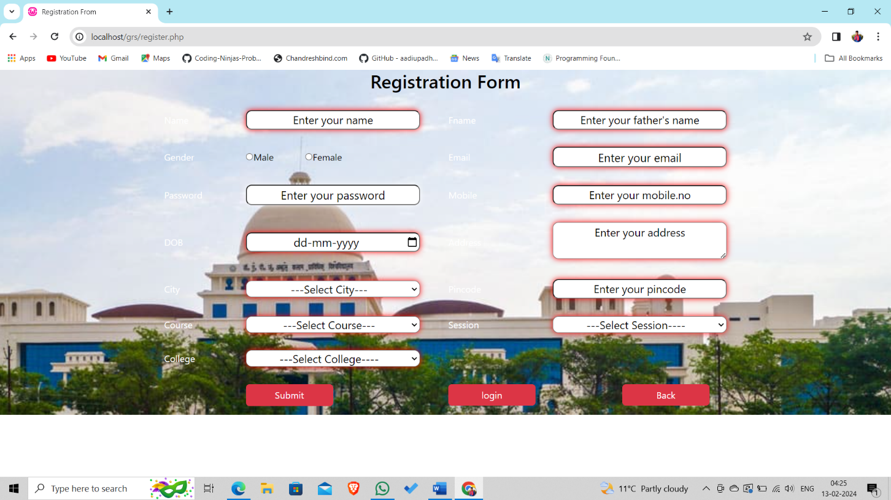
REGISTRATION

Slide 24
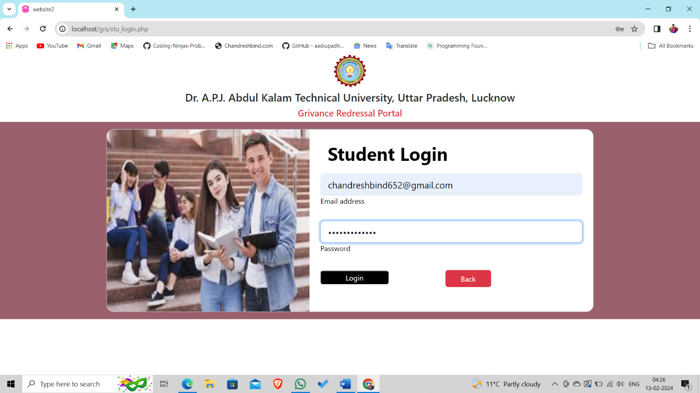
STUDENT LOGIN

Slide 25
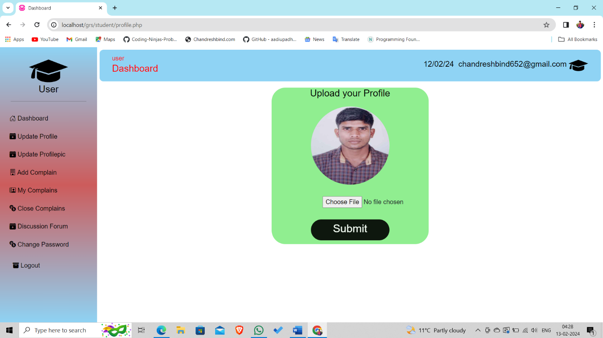
USER DASHBOARD

Slide 26
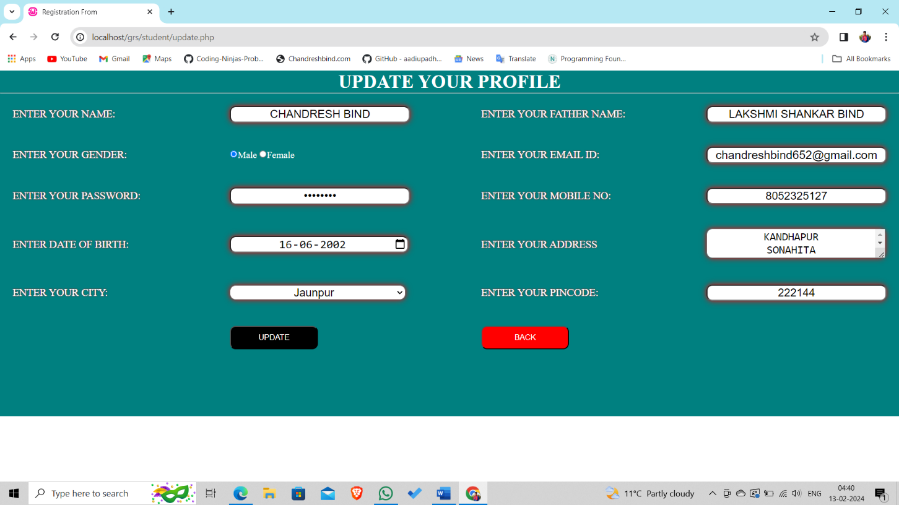
UPDATE PROFLIE

Slide 27
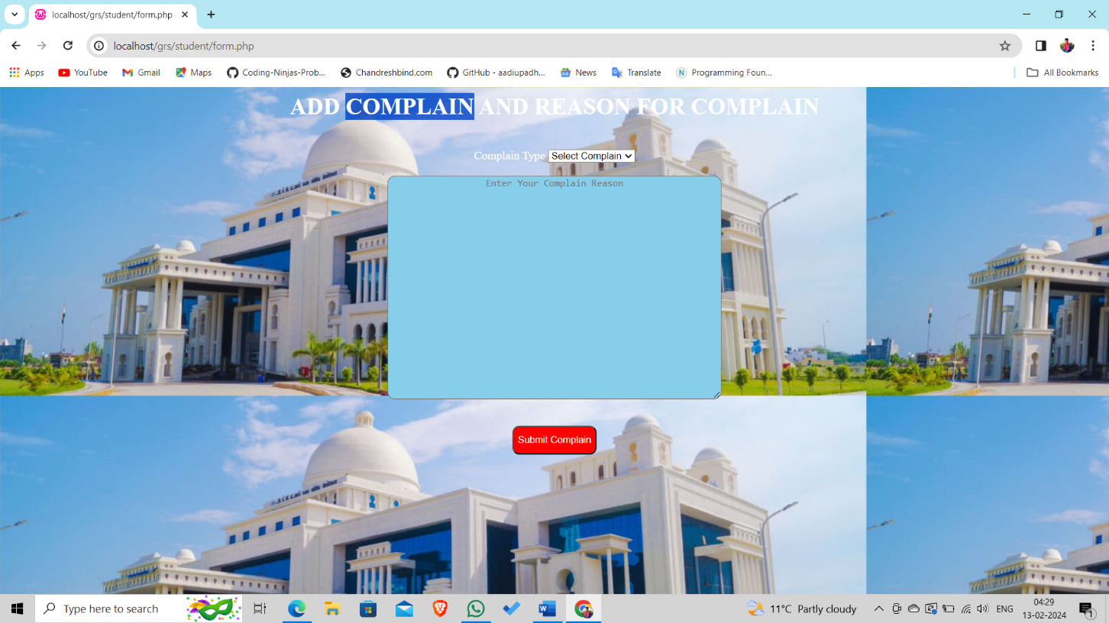
ADD COMPLAIN

Slide 28
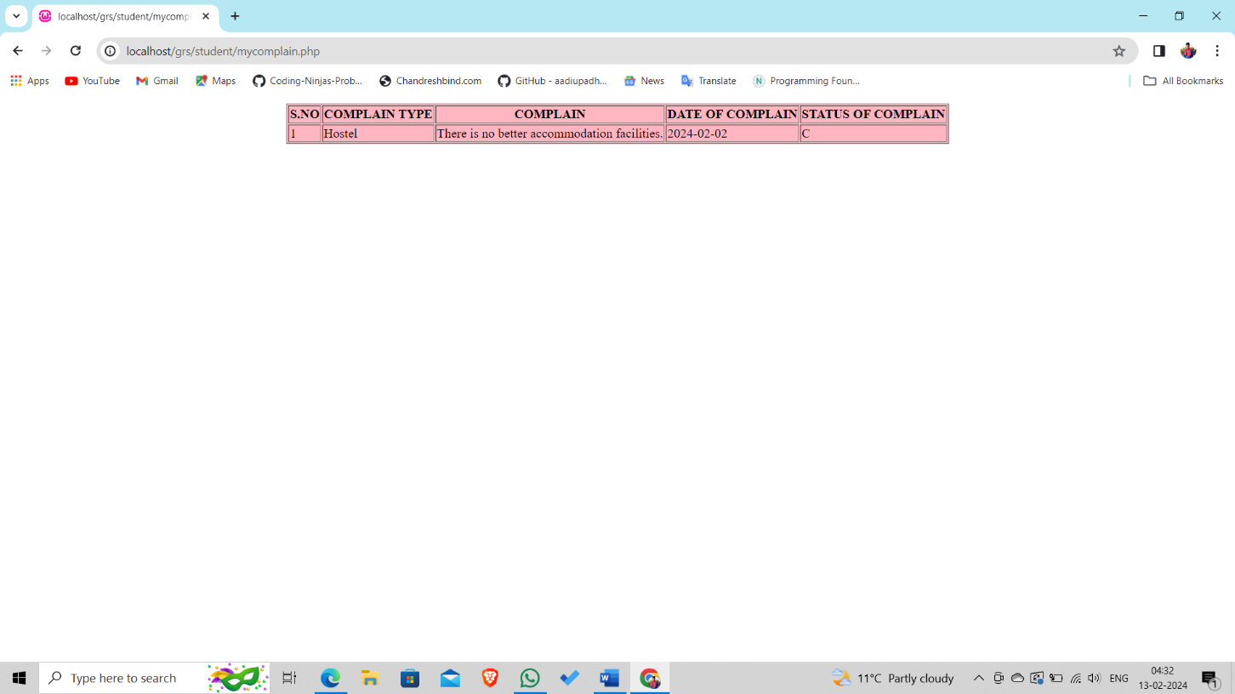
MY COMPLAINS

Slide 29
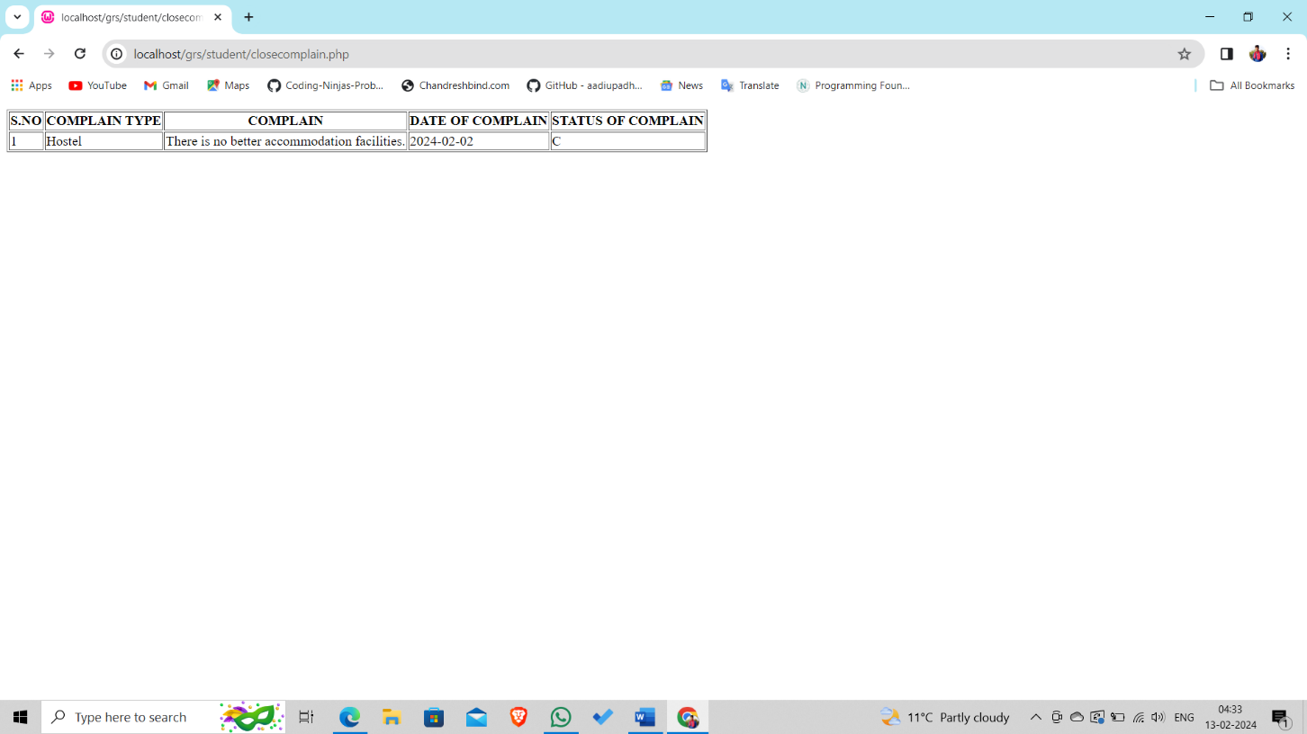
CLOSED COMPLAINS

Slide 30
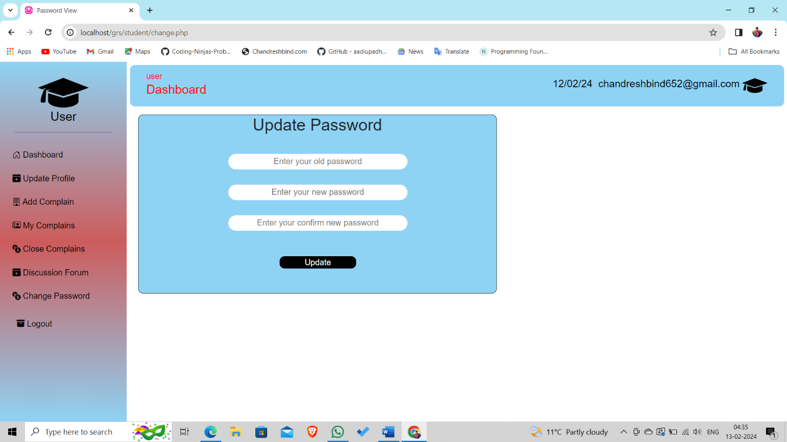
UPDATE PASSWORD

Slide 31
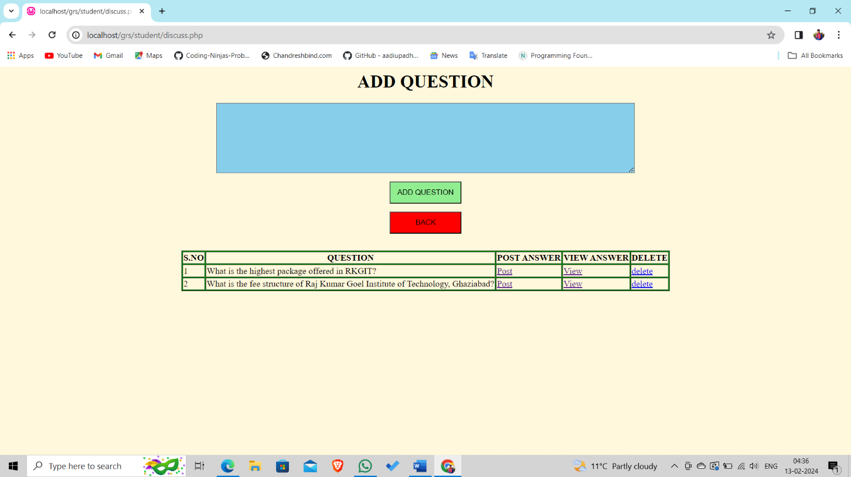
DISCUSSION FORUM

Slide 32
Advantages
It tracks all the information of various types of complains.
Manages the information of complainant.
Shows the information and description of the various complains and their solutions.
To increase efficiency of managing the university rules and regulations.
It deals with monitoring the information and feedbacks.
Adding, Editing, and updating of records is improved which results in proper data management of online complain system data.
It provides a fair and speedy means of grievance handling.
Builds harmonious education atmosphere in campus.

Slide 33
Conclusion
This Grievance Redressal System is an attempt to highlight the fact that there are hardly such systems prevailing curtailing to the complaint redressed for students enrolled in numerous organizations. This paper has demonstrated a proposed GRS system for the grievance redressed of students covering various domains of complaints which could be lodged easily and thus leading to easy and sure solutions or redressed to the problems being faced by a student on a regular basis. The technologies used comprise of HTML and CSS to design a user-friendly graphical user interface, PHP, and SQL to keep track of the records at the back end. This system would be suitable for any organization for the resolution of complaints and thus lead to a qualitative and quantitative development of the organization.
In future it is planned to develop our own web server to host the web application.
Building Android Application for the system is also one of the future scope’s of this project.

Slide 34
Thank You !

